Slide 1
Social Skills
PBIS Tier 2/3 Extending
Matt Berry & Tara Schilihan

Slide 2
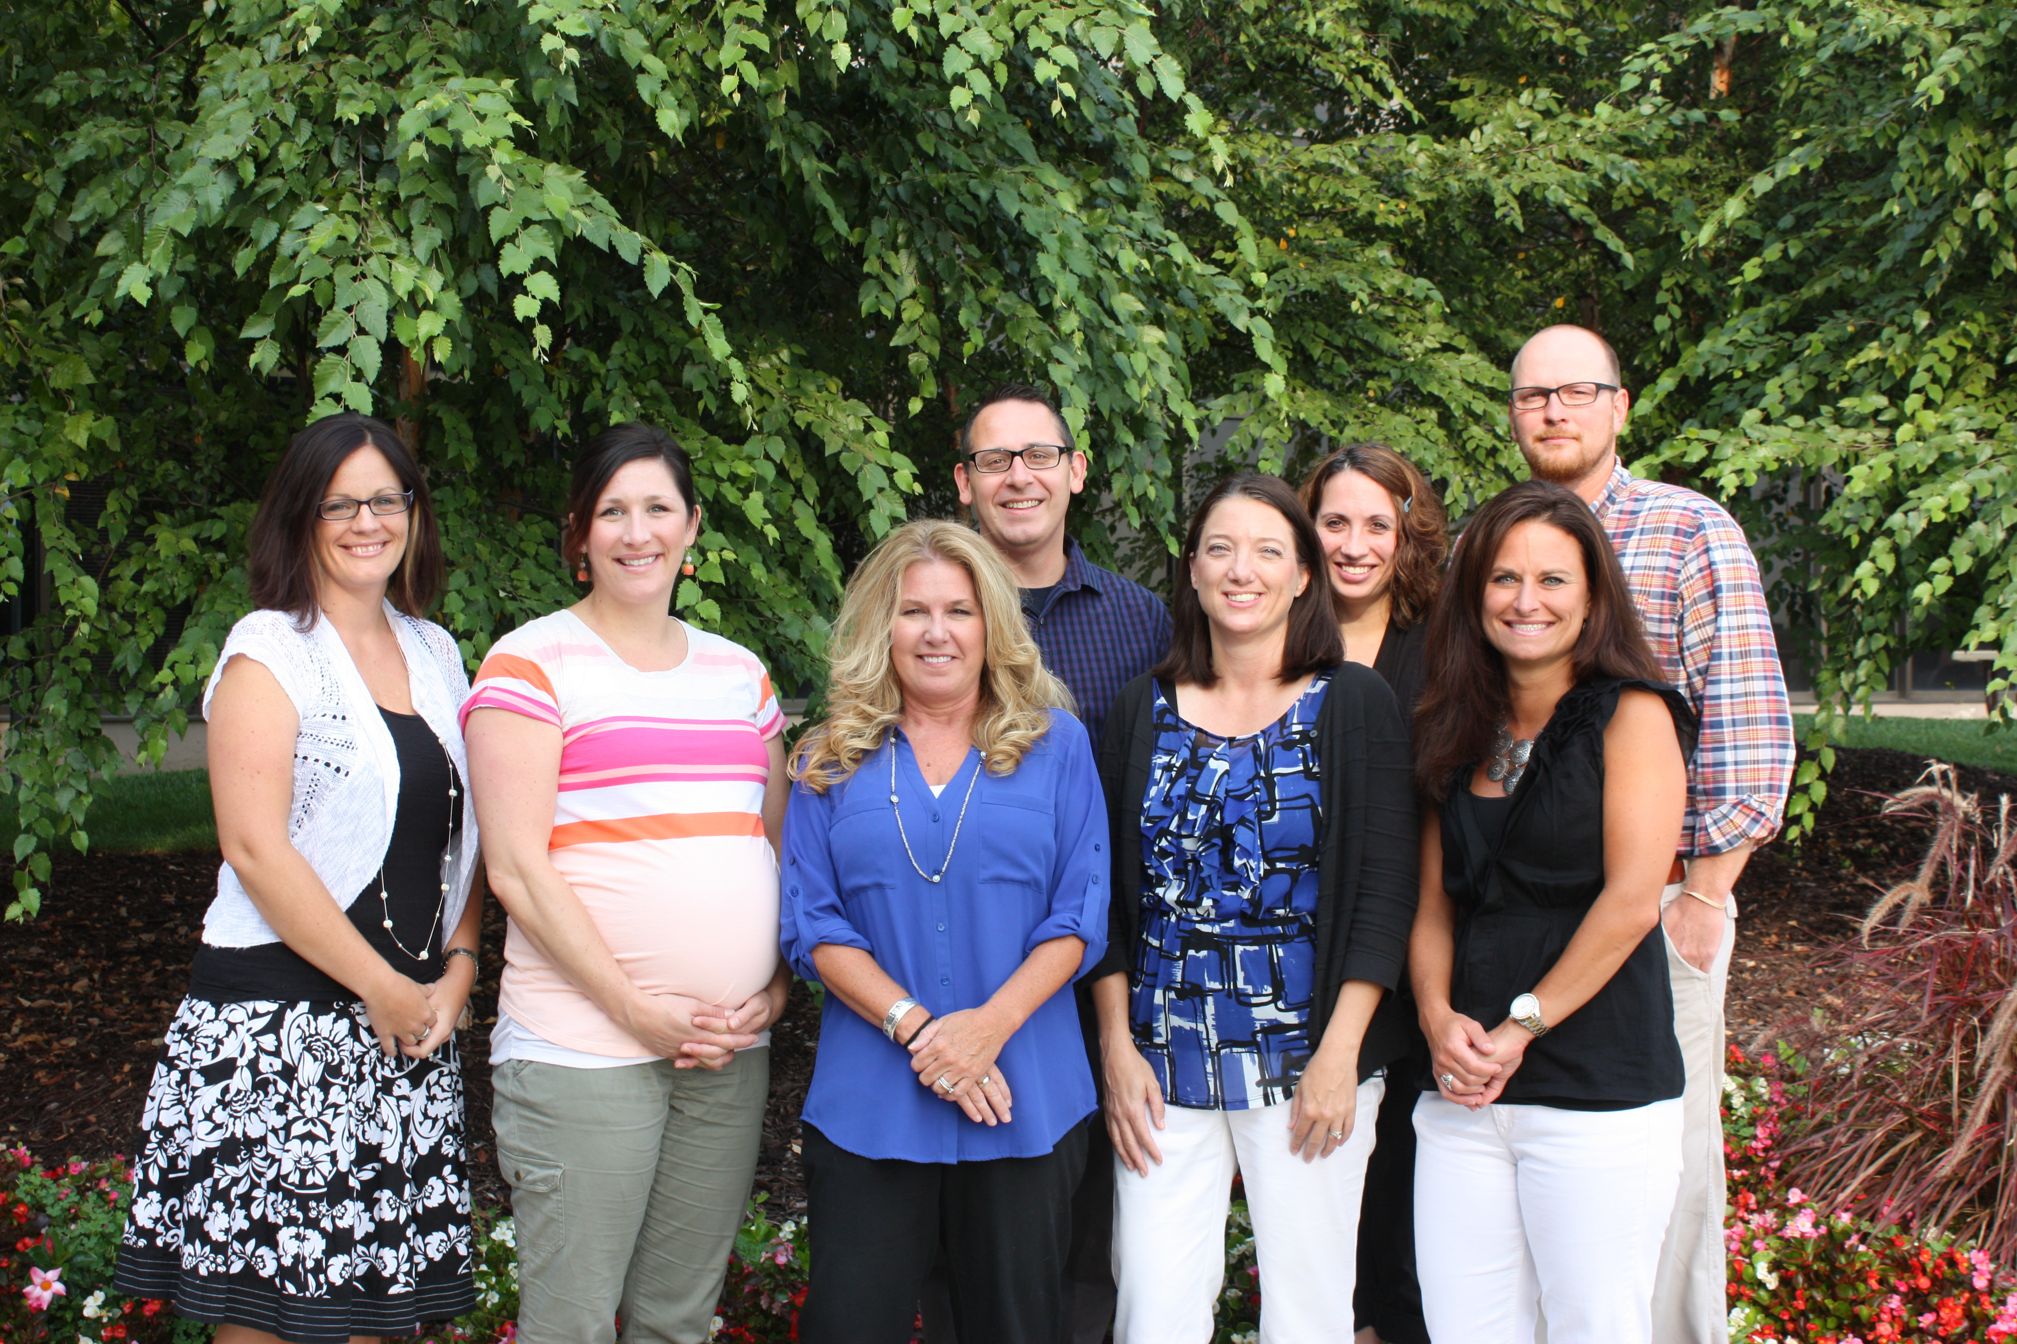
PBIS Team
Dr. Lisa Powers, Area Coordinator
Trish Diebold, MTSS/Data Specialist
Tara Schilihahn, PBIS Facilitator
Matthew Berry, PBIS Facilitator
Jamie Grieshaber, PBIS Facilitator
Taryn Gaskill, PBIS Facilitator
Ryan Guffey, PBIS Facilitator

Slide 3
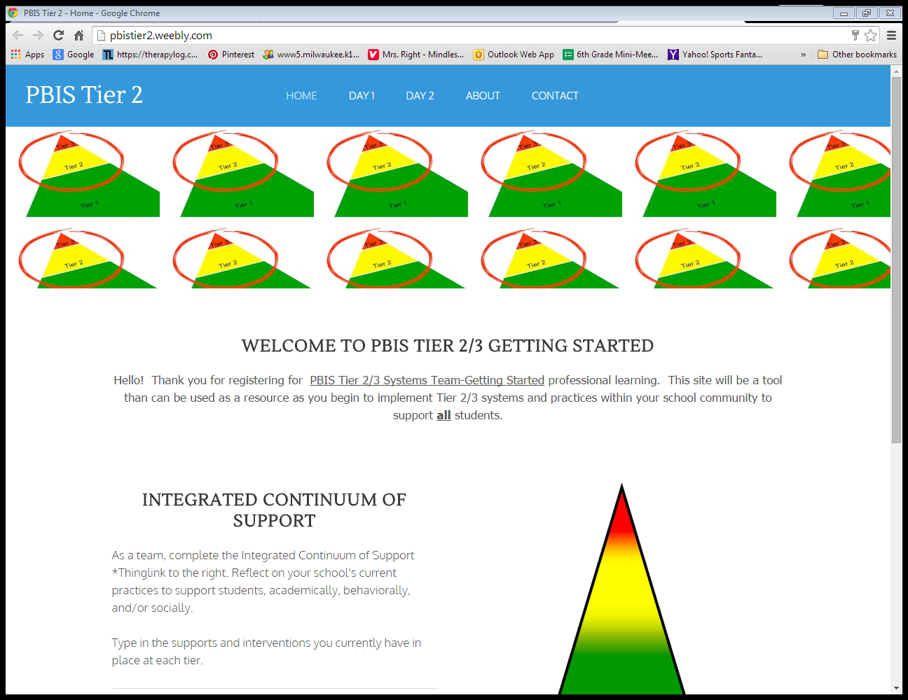
Online Companion
www.pbistier2.weebly.com
We will use for…
Presentation
All handouts and resources
Share information for feedback

Slide 4
Entering Activity: Social Skills Padlet
Answer the following questions on the
Social Skills Padlet
What is the current status of social skill instruction look like in your school or program?
Who is receiving social skill instruction? Are there any specific skills being targeted?

Slide 5
Professional Learning Outcomes
By January 2016, schools attending will have started to support a group of students, including students with disabilities, with social skill instruction.
By May 2016, schools attending will have and use systems and practices (defined in an implementation manual) for Tier 2 Social Skills Practices to support students who may benefit

Slide 6
Participant Outcomes
Learn systems and practices needed for a Tier 2- Social Skills intervention.
Facilitate action steps for installing Tier 2: Social Skills strategies with their PBIS 2/3 systems team.
Plan, teach, and monitor all critical components of Tier 2: Social Skills Strategies.

Slide 7
Student Outcomes
10-15% of student body will access Tier 2 interventions which includes students with disabilities.
70% or more, of students accessing Tier 2 and/or Tier 3 interventions will respond positively.

Slide 8
AGENDA
Tier 2/3 Systems to Support Instruction
Steps to Implementing Social Skills
    -Assess Needs
    -Develop Curriculum
    -Teach
    -Establish
    -Generalize
Activities Embedded in Learning
Progress Monitoring
ACTION PLANNING

Slide 9
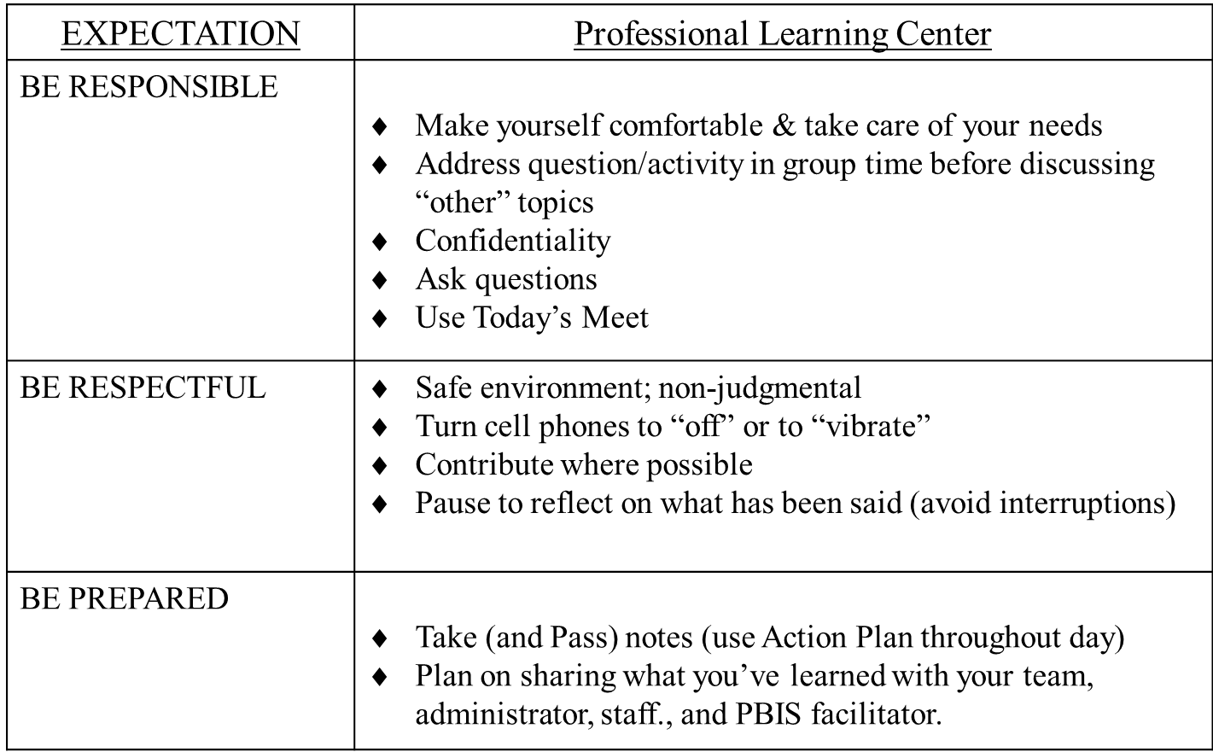
Professional Learning Behavioral Expectations

Slide 10
ROLL A THOUGHT ENTERING ACTIVITY

Slide 11
Tier 2/3 System to Support Social Skills

Slide 12
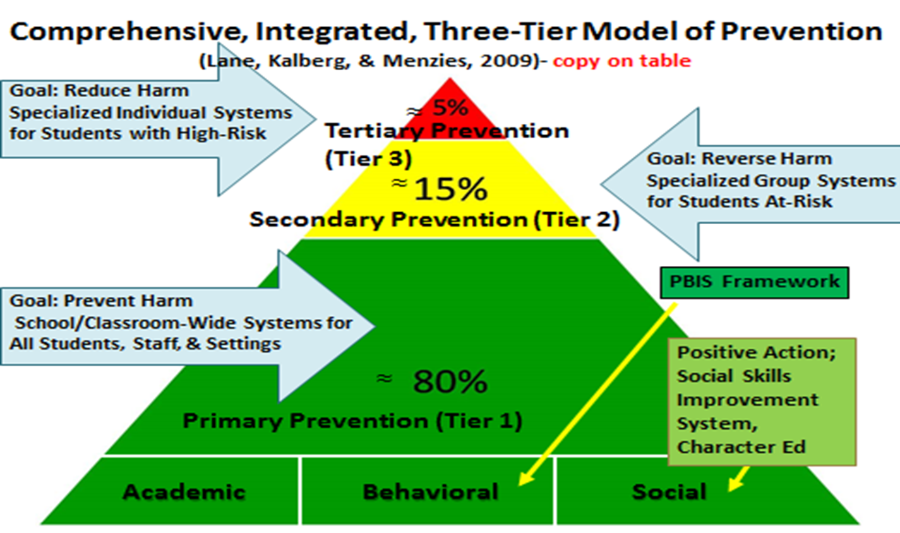
Notes:
We want students to have skills. If I am standing in line on Black Friday. I want the person next to me to have some social skills. Example.
Universally- how and what do you teach to all students academically, behaviorally, socially with self-management strategies?
Examples- writing checklist, walking in the hall, voice level
Today’s focus will be on moving from individual kiddos or whole group to supporting a tier 2 group
You have probably seen many triangles to represent similar frameworks – common in medicine and business, not to mention education. Ask – Who is familiar with RTI? Maybe seen a PBIS triangle. Here is a comprehensive triangle that shows us a model of prevention that includes academics, behavior, and social skills – these pieces are not separate. They fall under the same framework and each affects the other. When you look at this triangle, don’t think about each color being separate – think of them as layered. Green goes all the way from top to bottom – all students receive; the yellow is layered on top and goes all the way to the top (student receiving tier 2 interventions still receive Tier 1); same for the red (students receiving tier 3 interventions get interventions at all tiers). The tiers are fluid, students may need supports at different tiers for different things, and these needs can change. Important to label the intervention and not the student.

Slide 13
Universal
Targeted
Intensive
Integrated Continuum of Support for ALL
Math
Science
Spanish
Reading
Soc skills
Soc Studies
Basketball
Label behavior…not people
Dec 7, 2007
Notes:
Double click so that two elements pop up at one time. This is to demonstrate strengths of the students and thinking of strengths and needs in a more specific way rather than labeling people. Such as they are in the red group in math, they are a tier 3 student

Slide 14
Universal
Targeted
Intensive
Integrated Continuum of Support for ALL
Math
Science
Spanish
Reading
Soc skills
Soc Studies
Basketball
Label behavior…not people
Dec 7, 2007
Notes:
Today we are going to develop systems for students who need support with social skills, or additional behavioral supports. or Double click so that two elements pop up at one time. This is to demonstrate strengths of the students and thinking of strengths and needs in a more specific way rather than labeling people. Such as they are in the red group in math, they are a tier 3 student

Slide 15
3-Tiered System of Support
Necessary Conversations (Teams)
Universal
Team
Secondary Systems Team
Problem Solving Team
Tertiary Systems Team
Uses Process data; determines overall intervention effectiveness
Uses Process data; determines overall intervention effectiveness
Plans SW & Class-wide supports
Standing team; uses FBA/BIP process for one youth at a time
Universal Support
CICO
Problem-Solving with Function in Mind
Social Skills
Behavior Contracts
Self-Management
Newcomers Club/Mentors
Study/ Organizational Skills
Complex
FBA/BIP
WRAP
RENEW
Problem -solving
SSD PBIS Adapted from : Eber, L. T301fi: Tertiary Level Support and Data-based Decision-making in Wraparound [Presentation Slide].
Retrieved from Tier 3/Tertiary Series Training Resource Guide (2010). Illinois PBIS Network
Notes:
15
15
As we move on to systems now- keep in mind what type of questions will you ask the staff around social validity. (possibly make a running tab)
We looked at our universals in place and made some notes on what will be sustained and what will be continued to monitored.
Now we will start into the systems.

Slide 16
Identifying Students for Social Skills
Universal Screeners
Student Outcome Data
                Office Discipline Referrals
                Suspensions
                Attendance
                Tardies
                Academics
                Minors
                In-School Detentions
                Interclass Time-out
                Think Time
At least 2 data sources are used to identify students for Tier 2 & Tier 3 supports at least three times a year

Slide 17
Developing Decision Rules for Social Skills
Everyone needs to know how students are eligible (entry criteria) for interventions
Everyone needs to know how progress is monitored
Everyone needs to know how students exit the intervention

Slide 18
Developing Decision Rules for Social Skills
Student Selection Decision Rule Example
Measure | Proficient Score | Indication of Risk
1. Mid-quarter review of discipline records | 0-6 | 7+ entries on discipline record form
2. Screening | Low or little risk range | Score in Moderate to High risk range
3. Attendance | 95% | Less than 95%
4. Number of Ds & F’s | 2.5+ with no failing grades | 2+
5. Tardies to school | 0-2 | 3+

Slide 19
INTERVENTION GUIDELINES
Support | Description | School-wide Data: Entry Criteria | Data to Monitor Progress | Exit Criteria
The Name of the Intervention Academic, Behavioral, Or Social Skills Grade Level | A Brief description of what the intervention is, length of time, and what the outcome would be. Resources allocated to the intervention | Data sources that determine which students are best for this intervention Function Based Attention or Avoidance | Process on how data will be monitored Process on how often data will be monitored What data will be monitored | Data sources that will determine when: Adjustments need to be made Fading in order to graduate Discontinuation of interventions

Slide 20
SOCIAL SKILLS INTERVENTION GUIDELINES
Support | Description | Schoolwide Data: Entry Criteria | Data to Monitor Progress | Exit Criteria
Social & Academic Social Skill Instructional Groups | -Focuses on improving students’ social skills. -Two/three days a week -Sessions conducted by counselor and or teacher during Student Success (Advisory) or AE Examples: -Problem-solving: To learn replacement behaviors for fighting, arguing, etc. -Pro-social Skills: To learn replacement behaviors for avoidance, withdrawal, etc. -Academic Behaviors: To learn replacement behaviors for getting out of seat, calling out during instruction, poor studying habits, etc. -Internalizing Behavior: | To be considered data must meet two out of the following areas: -Academic & behavior concerns which look like: Screening score in moderate-risk range on the SRSS, Three or more ODRs in a trimester Two or more out of school suspensions Failing 2 or more core academic classes 3 or more unexcused absences AND -Function of student behavior related to peer-related problems | -Reduction in ODRs -Daily social skills checklists (Cool Card) -Direct observation(teachers) -Grades -Attendance -Behavior surveys Data Example: After 4-6 weeks of the social skills instructional group, 7 of the 8 students have earned 80% or more of their Cool Card points and there has been a 50% reduction in total ODRs for the 8 students. | -Student scores in the low-risk status during the next screening -No ODRs related to peer problems during the reporting cycle -Students are able to exhibit generalized skill in specific setting
Support | Description | School-wide Data: Entry Criteria | Data to Monitor Progress | Exit Criteria
The Name of the Intervention Academic, Behavioral, Or Social Skills Grade Level | A Brief description of what the intervention is, length of time, and what the outcome would be. Resources allocated to the intervention | Data sources that determine which students are best for this intervention Function Based Attention or Avoidance | Process on how data will be monitored Process on how often data will be monitored What data will be monitored | Data sources that will determine when: Adjustments need to be made Fading in order to graduate Discontinuation of interventions

Slide 21
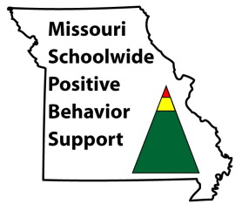
TIER 2 INTERVENTIONS
Academic or behavior interventions are strategies or techniques applied to instruction in order to teach a new skill, build fluency in a skill, or encourage the application of existing skills to a new situation.
MO Dept. of Elementary & Secondary Education,
Special Education, Compliance
Notes:
Just as happens at Tier 1, Tier 2 interventions focus on teaching. At Tier 2 students receive a higher dose of direct instruction on skills related to organization, social interactions and/or academic success.
To be considered as an “intervention” strategies provided should include teaching and instruction of identified skills.
Much of this information is on the state website, we have aligned ourselves with state expectations

Slide 22
TIER 2 INTERVENTIONS
For students who…
  Are at-risk for an academic and/or social-behavioral concern
  Continue to engage in frequent problem behavior despite effective school wide, tier 1 prevention efforts
  Need additional teaching, monitoring and feedback
  Could benefit from extra attention or support at school before they are in crisis
(Crone, Hawken & Horner, 2010)
Notes:
Tier 2 prevention is designed for students who are not responding to the Tier 1 level of support.

Slide 23
TIER 2 INTERVENTIONS
For students with…
Low level problems
  Non-compliance, disrespect
  Work completion
  Attendance, tardy
ODR 2-5, classroom minor 4-6 range
Behavior occurs across multiple locations
Students with internalizing concerns, but not self-injurious
Notes:
Tier 2 prevention is designed for students who are not responding to the Tier 1 level of support.

Slide 24
KEY FEATURES of TIER 2 INTERVENTIONS
Criteria for access to Tier 2 interventions is clearly established
All staff trained on how to make a referral, and how to implement the intervention
Data are used continuously to monitor progress and to determine when a student will exit the intervention or when supports will be intensified.
System for communicating with participating student, staff and families is developed
Notes:
Tier 2 prevention is designed for students who are not responding to the Tier 1 level of support.

Slide 25
KEY FEATURES of TIER 2 INTERVENTIONS
Continuous availability & quick access to the intervention
Similar implementation across students
Low effort by classroom teachers
Intervention is consistent with School-Wide Expectations
Notes:
Tier 2 prevention is designed for students who are not responding to the Tier 1 level of support.

Slide 26
Reflect & Review
Leadership to support Social Skill Instruction
Data to identify who might benefit from Social Skills Instruction
Procedures to communicate with staff, student, families
Documented Plans for Social Skills Instruction
Current strengths of PBIS Tier 1 & Tier 2 Systems team or areas for improvement
Social Skills Padlet Activity
Notes:
Reflect on the following questions:
Do you have leadership support to implement social skill instruction?
Do you have data accessible to identify students? If not, what are the barriers that need to be addressed?
How is communication currently happening to staff and families when students are in need of Tier 2 supports?
What are the current strengths of Tier 1 & Tier 2 systems teams? How will you connect what is learned back to the Tier 2 team?

Slide 27
Social Skills Instruction
Critical Features

Slide 28
STEPS TO IMPLEMENTING SOCIAL SKILLS
1. Assess
– Identify most common social skill deficits
2. Develop Curriculum
– Bank of lessons readily available to address skills deficit
3. Teach
– Tell, Show, Practice, Practice, Practice
4. Establish Procedures
– Logistics of facilitating the Social Skills Intervention & Group Management techniques
5. Plan for Maintenance & Generalization
– Consistent use of skills over time & across variety of settings

Slide 29
ASSESS SOCIAL SKILL DEFICITS
Identify Most Common Social Skill Deficits
Notes:
Missouri Guidance Activity

Slide 30
ASSESS COMMON DEFICITS
Frequently identified deficits
Active Listening
Following Directions
Staying Calm when receiving feedback
Compromising
Asking for Help
Respectful Disagreement

Slide 31
Broad Dimensions of Social Skills
Cooperation or Compliance Skills
Self-Management
Assertion Skills
Peer Relations Skills
Academic Skills
Empathy

Slide 32
Basic Curriculum
Cooperation
Active Listening
Following Directions
Self-Management
Staying Calm
Compromising
Assertion
Asking for Help
Respectful Disagreement

Slide 33
Peer Relations
Completing Others
Leadership Skills
Supporting Peers

Slide 34
Academic
Accomplishing tasks or assignments
Heeding teacher directions
Producing quality work

Slide 35
Assess Common Deficits
What problem behaviors are commonly demonstrated by at-risk students in our buildings?
List behaviors that have been referred to the office or are considered a minor behavior incident.
Activity

Slide 36
STEPS TO IMPLEMENTING SOCIAL SKILLS
1. Assess
– Identify most common social skill deficits
2. Develop Curriculum
– Bank of lessons readily available to address skills deficit
3. Teach
– Tell, Show, Practice, Practice, Practice
4. Establish Procedures
– Logistics of facilitating the Social Skills Intervention & Group Management techniques
5. Plan for Maintenance & Generalization
– Consistent use of skills over time & across variety of settings

Slide 37
DEVELOP CURRICULUM
Develop a Bank of Lessons Readily Available to Address Missing Skills

Slide 38
Develop Curriculum
Social skills curriculum must match the identified concerns
An ideal curriculum does not exist.
A basic set of “Preferred Teaching Practices” exists.
Design a curriculum that incorporates your school-wide expectations and teaches social skills replacements for most common concerns.

Slide 39
Selecting Curriculum: (What to Teach)
I am…. | All Settings | Classroom | Hallways | Cafeteria | Bathrooms | Playground
Safe | Keep bodies calm in line Report any problems Ask permission to leave any setting | Maintain personal space | Walk Stay to the right on stairs Banisters are for hands | Walk Push in chairs Place trash in trash can | Wash hands with soap and water Keep water in the sink One person per stall | Use equipment for intended purpose Wood chips are for the ground Participate in school approved games only Stay in approved areas
Respectful | Treat others the way you want to be treated Be an active listener Follow adult direction(s) Use polite language Help keep the school orderly | Be honest Take care of yourself | Walk quietly so others can continue learning | Eat only your food Use a peaceful voice | Allow for privacy of others Clean up after self | Keep body to self Line up at first signal Invite others who want to join in Enter and exit building peacefully Share materials Use polite language
A Learner | Be an active participant Give full effort Be a team player Do your job | Be a risk taker Be prepared Make good choices | Return to class promptly | Use proper manners Leave when adult excuses | Follow bathroom procedures Return to class promptly | Be a problem solver Learn new games and activities
Notes:
Tier 2 prevention is designed for students who are not responding to the Tier 1 level of support.

Slide 40
WHAT TO TEACH
Skill Deficits | Actions & Interventions
Social Skill Strengths: student knows and uses social skills consistently and appropriately | Reinforce to maintain desired social behavior Use student as a model for other students
Performance Deficits | Use behavior techniques to increase student practice and performance of desired social behavior
Frequency Deficits | Provide extensive opportunities to practices across a wide range of exemplars
Acquisition Deficits | Direct instruction of the desired social behavior
Competing Problem Behaviors | Use behavior techniques to reduce interfering behaviors Collect further information (e.g. FBA - direct observations, interviews, comprehensive assessment of problem behaviors).
Notes:
Social skills- intended for the students who have acquisition deficits- they have been taught social skills but are not demonstrating the behavior because they cant versus you have seen them do it and they wont (that is performance). Skill deficit vs. performance deficit

Slide 41
Critical Features of Social Skills
Acquisition Deficits - CAN’T DO
                Absence of knowledge for executing skill or failure to discriminate which social behaviors are appropriate in specific situations
                Performance Deficits – WON’T DO
                Skill is present in repertoire, but student fails to perform at acceptable levels
                Fluency Deficits
                Lack of exposure to sufficient or skilled models of social behavior, insufficient rehearsal/practice or low rates of inconsistent delivery of reinforcement of skilled performances
Notes:
Important to distinguish because intervention will vary for each.

Slide 42
Critical Features of Social Skills
Initial Social Skills
Expressing Feeling Skills
Social Relationship Skills
Classroom Skills
Decision-Making & Problem Skills
Conflict Management Skills
Self-Management Skills
                http://pbiscompendium.ssd.k12.mo.us/ResourcesSchools/SSD/SocialSkills/socialskills.html
Notes:
Tier 2 prevention is designed for students who are not responding to the Tier 1 level of support.

Slide 43


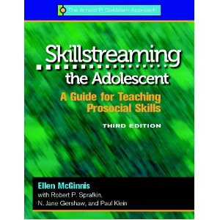

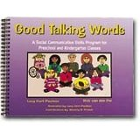
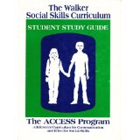




Curriculum Resources
Smore Resource Page
Skill Streaming
Good Talking Words
PATHS
Second Steps
Smore Resource Page
Notes:
Benefits from K.Lane- Advantage is that all materials and lesson plans are provided, been well researched, evidence supports the utility of the program when implemented as designed.
Resource table where you can explore additional resources

Slide 44
Missouri Guidance Curriculum
                Small Group Counseling Units
                New Students (6-8)
                Self-Awareness (K-2, 3-5)
                Self-Control (K-2, 3-5)
                Study Skills (K-2, 3-5, 6-8, 9-12)
Notes:
Tier 2 prevention is designed for students who are not responding to the Tier 1 level of support.

Slide 45
Considerations for Curriculum
                Considerations
                What instructional components are included in the curriculum?
                Can the curriculum be used with small groups?
                Can personnel implement the curriculum without specialized training beyond that described in the in the curriculum?
                Is the cost implementation reasonable and manageable?
                Are strategies included that will promote maintenance and generalization of skills?
Notes:
Tier 2 prevention is designed for students who are not responding to the Tier 1 level of support.

Slide 46
Selecting Curriculum
                Does the selected curriculum address the replacement behaviors your team identified as important for at-risk students in your building?
Notes:
Tier 2 prevention is designed for students who are not responding to the Tier 1 level of support.

Slide 47
Curriculum Questions
How do you currently use social skills curriculum?
                What curriculums are you using?
                What are the benefits/barriers to your social skills curriculum?
                What are some questions you may be having?
Notes:
Tier 2 prevention is designed for students who are not responding to the Tier 1 level of support.

Slide 48
Matrix Match Activity
Looking at Your Matrix & at Your Identified Problem Behaviors What Replacement Behaviors Would Need to be Taught

Slide 49
Curriculum Walk Activity
Look at Curriculum
Choose two Lessons that would meet the need of two different identified replacement behaviors.

Slide 50
STEPS TO IMPLEMENTING SOCIAL SKILLS
1. Assess
– Identify most common social skill deficits
2. Develop Curriculum
– Bank of lessons readily available to address skills deficit
3. Teach
– Tell, Show, Practice, Practice, Practice
4. Establish Procedures
– Logistics of facilitating the Social Skills Intervention & Group Management techniques
5. Plan for Maintenance & Generalization
– Consistent use of skills over time & across variety of settings

Slide 51
TEACH SOCIAL SKILLS
Develop a Bank of Lessons Readily Available to Address Missing Skills

Slide 52
Misbehavior = Learning Error
                Students learn appropriate behavior in the same
                way they learn how to read:
                Focus on:
                Explicit Instruction
                Practice
                Feedback
                Encouragement
Notes:
Reiterate what this intervention will be made from – emphasize the teaching aspect
Problem behavior is something that was learned.

Slide 53
THE POWER OF TEACHING
“If a child doesn’t know how to read, we teach.”
“If a child doesn’t know how to swim, we teach.”
“If a child doesn’t know how to multiply, we teach.”
“If a child doesn’t know how to drive, we teach.”
“If a child doesn’t know how to behave, we … … teach? … remove? … punish?”
Why can’t we finish the last sentence as automatically as we do the others?
Notes:
We are going to teach students how to have positive behavior.
We are not going to teach them how not to do something but how to do something.

Slide 54
SOCIAL SKILLS
“Those behaviors which, within a given situation, predict important social outcomes for children.” – Gresham 1986
- interactive, requires at least 2 people
- maintained by social reinforcement, keep skills that work
and discard those who don’t
It is our responsibility to assess what skills most predict success in our students
- direct observation
- ask significant others
Notes:
You need two people for their to be social skills.
In the school, use social skills that will make kids successful.
Relationships
How do we know what to teach? Example: handshaking. When do you shake someone’s hand?
Stealing a ball because I do not know how to ask to play. I want attention and my behavior is maintained by the reinforcement. How can students get the same reinforcement by exhibiting the appropriate social skill?
.

Slide 55
TEACHING SOCIAL SKILLS
Teach same as you would any academic skill
  Teacher modeling of key skills
  Student practice with teacher guidance
  Individual practice with real examples
Use strategies to promote generalization
Example selection and sequencing
Formative assessment via curriculum

Slide 56
TEACHING SOCIAL SKILLS
Teach Social Skills Like You Would Teach Academics!
Clear set up and positive engagement
Behavior management
Teach lessons
Model and demonstrate
Guided practice
Review and test
Promote maintenance and generalization

Slide 57
LESSON DEVELOPMENT & TEACHING
Training Outline for Each Session (45-60 min)
Review of Previous Skill (5-10 min)
Teach Weekly Skill (20 min) Tell, Show, Practice
Group Debriefing (5-10 min) Practice
Socialization Time (10 min) Practice
Establish a Weekly Goal (5-10 min)

Slide 58
Review of Previous Skill
Discuss homework,
Reinforce those who returned homework
Reinforce those who met weekly goal
*During first meeting of the group, this time will be used to establish group rules and procedures

Slide 59
TEACHING SOCIAL SKILLS
Set-Up
Bring Group Together
Tell them why they are there
    We are here to practice easy things that will help make friends and help you do well in school
Tell them what will occur in group
Try to engage students positively from the very beginning
Notes:
Not because you are bad, or because I said so.
We are going to learn ways for your teacher to say, You are doing a great job!

Slide 60
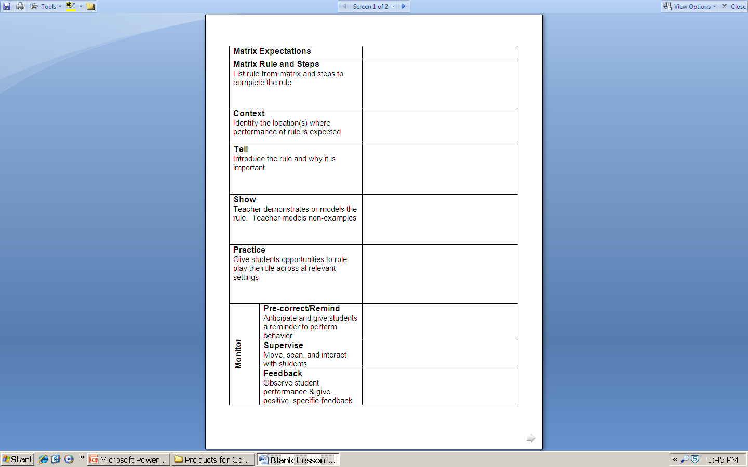
TEACHING SOCIAL SKILLS
Rationale/Defining the Skill-The Context
Modeling- Tell/Show
Role-Playing- Show
Performance Feedback- Practice
Generalization- Embedded throughout
Notes:
We want to make sure that we are using a lesson format that teaches the critical features

Slide 61
Teach Weekly Skill
- Establish the need to learn the skill (teach)
- Teach with cue cards (teach)
– Elicit real life examples (show)
– Model (show)
– Role play with on-going feedback (Practice)
– Additional practice opportunity & homework (Practice & Generalization)

Slide 62
RATIONALE & DEFINING THE SKILL
The goal is to help students understand the skill to be taught
Ask for student input through dialogue
Connect the rationale for using the skill to various settings
State how the skill will benefit the student

Slide 63
TEACHING SOCIAL SKILLS
Lesson Components
Rule for why to use the skill
Rule for when to use the skill
  And for when not to use the skill
  Set of useful skill variations
  Natural examples
Notes:
You could do it like this. You could walk away, you could tell a friend, you could count to ten, you could tell a teacher, you could ask someone
Natural examples are examples that come from the teacher. Give me four or five examples when this has occurred. The teacher say’s, they were on the playground and someone called him a “fathead” so then in class you say, “so let’s say you are on the playground and someone comes up and calls you a ‘fathead’

Slide 64
TEACHING SOCIAL SKILLS
Model/Demonstrate the Skill
Teacher provides first model and questions
Select competent and respected students and adults
Only the teacher models incorrect responses
Select examples from natural context
At least two positive demonstrations of each example
Notes:
Model the appropriate social skill and ask what did I do right?
Use demonstration of skill in natural group setting.
Have them be judges. Discuss what will that look like.
Then as a model demonstrate the skill the wrong way. Can they identify that? Ask what would happen if I did that?

Slide 65
TEACHING SOCIAL SKILLS
Only the teacher models negative behavior – never the students
Have students tell you why wrong and what bad things would happen as a result
Notes:
Have them be judges. Discuss what will that look like.
Then as a model demonstrate the skill the wrong way. Can they identify that? Ask what would happen if I did that?

Slide 66
EXAMPLE OF RATIONALE
Teacher might say, “Today’s skill is an important one, it is called dealing with an accusation. Can anyone tell me what an accusation is?
Allow students to give examples
Teacher might say, “ An accusation happens when someone may believe that you did something and they may accuse you. You may have done it, or you may not have. Most times, it is upsetting to be accused of doing something whether you did it or not. So the skill we are going to learn today is how to handles these types of situations both at school and in the community.”
Notes:
Teach students to use a “soft voice” inside voice. Not yelling, I did not do that! No! No! I did not do that!
When I use that voice…the teacher get’s mad and I never get to tell the teacher what really happened.

Slide 67
SKILL STEPS
Construct poster of skill steps to be taught
Connect skill steps to steps of social skills daily progress report
Some students might require skill step cards for a visual prompt
Asking for Help
Ask yourself, “Can I do this alone?”
If not, raise your hand.
Wait, say to yourself, “ I know I can wait without talking.”
Ask for help in a respectful way

Slide 68
MODELING
Use at least two examples for each skill demonstration.
Select situations relevant to students’ real-life circumstances (cultural context)
The model should be portrayed as a reasonably similar to the group member in age, socioeconomic background, verbal ability
The model should think out loud
Modeling should depict positive outcomes, the model using the skill should always be reinforced
Model displays should depict all of the behavioral skill steps in the correct sequence
Model only one skill at a time

Slide 69
EXAMPLES AROUND MODELING
Help students to identify behavioral skill steps while modeling unfolds
The model should “think aloud”
At the conclusion of modeling the teacher might ask, “Did I follow the first step?” How do you know I did this?”
The model may also provide self-reinforcing talk such as “ I think I followed all of the steps, I did a good job.”

Slide 70
Group Debriefing
Review performance of members,
Provide feedback,
Prompt peer feedback,
Vote on adherence to group rules,
Provide reinforcers

Slide 71
PERFORMANCE FEEDBACK
Review & Test
Positive feedback should always be given first
Feedback should be based upon how well the student followed the behavioral steps, not their acting
Constructive feedback and error correction should occur if a student did not perform a skill step
Student should be allowed to practice and role play if error occurs
Videotaping allows students to reflect on their own role play, allowing them to reflect on both their verbal and non-verbal behavior

Slide 72
Socialization Time
Socialization Time (Practice)
Allow students to interact in semi-structured play
Prompt students to use skill learned
Provide feedback
Prompt peer feedback

Slide 73
TEACHING SOCIAL SKILLS
Review & Test
Review essential rule for the day
Test on untrained examples through role plays
Test each student as often as possible (daily)
Request demonstration of skill whenever possible (verbally or role play)
Lesson homework
Notes:
Everyone should demonstrate it and know that they get it
Use examples that we have role played before then add examples we have not used and celebrate it when they get it right

Slide 74
GENERALIZATION PROMPT
With whom will I try this?
When?
What happened?

Slide 75
TEACHING STRATEGIES
# | Task Indicator
4a | Introduce a problem and a key skill as a solution
4b | Provide physical models while thinking aloud key steps
4c | Sequence positive examples then juxtapose negative
4d | Frequent questions to students – “is this right or wrong?”
4e | Differentiate instruction as necessary for individuals
4f | When students answer correctly –introduce role plays
4g | Provide all students with tasks during role play (judges)
4h | All students role play each skill to mastery
4i | Test with novel examples
At your table, discuss how this may look for your Social Skills intervention.

Slide 76
STEPS TO IMPLEMENTING SOCIAL SKILLS
1. Assess
– Identify most common social skill deficits
2. Develop Curriculum
– Bank of lessons readily available to address skills deficit
3. Teach
– Tell, Show, Practice, Practice, Practice
4. Establish Procedures
– Logistics of facilitating the Social Skills Intervention & Group Management techniques
5. Plan for Maintenance & Generalization
– Consistent use of skills over time & across variety of settings

Slide 77
ESTABLISHING PROCEDURES
Plan to Consider the Following:
When to meet?
Where to meet?
Who are group participants?
How many participants?
What are relevant skills?
How long will this take?
Who will teach?

Slide 78
SCHEDULING & LOGISTICS
Who & how many in the group?
– 4-8 (if possible select even number of students)
– Similarity in age/developmental level
– Even distribution of boys and girls
– Common problems/concerns
– Balance in severity of issues

Slide 79
SCHEDULING & LOGISTICS
Establish Procedures
• Who teaches?
– Access to 2 adults for each group
– Clear roles and responsibilities between adults
• When & how long meet?
– At least weekly, 45-60 minutes
– May require as many as 10- 20 weeks
– Before, during, or after school?

Slide 80
SCHEDULING & LOGISTICS
# | Task Indicator
1a | Consistent meeting time (30 min 2 x times per week)
1b | Instructional setting (room) available and scheduled
1c | 6-8 students with similar needs identified for group
1d | Schedule to teach no more than 1 relevant skill per week
1e | Schedule at least 2 weeks for each identified skill
1f | Have a consistent teacher identified for each session
At your table, discuss how this may look for your Social Skills intervention.
Terrance Scott, 2012

Slide 81
GROUP MANAGEMENT STRATEGIES
Establish Procedures
• Basic behavior management
– Attention signal
– Expectations & routines
– Incentives (stay within SW system)

Slide 82
GROUP MANAGEMENT STRATEGIES
Key is to develop a set of group rules that work to maintain focus on active participation and focus on instruction.
Because these students are likely to have some challenging behaviors it is best to have a point system in place to start.
Develop tricks and strategies for maintaining attention and desired behavior.

Slide 83
GROUP MANAGEMENT STRATEGIES
Teach a set of basic group rules in the first session
Example:
  Listen-look at the person who is talking and stay quiet
  Participate-do what teacher tells you to do
  Freeze – stop everything you are doing and become a statue
Teach this as a lesson
Notes:
Could do this with Secondary Students. The freeze rule is a way to say the role play is over.
Use the point system to keep them on target.
Point system may have to be worth something. Extra computer time.
Freeze, Set, Action Cut
Assign Judges & Coaching
Tag In

Slide 84
GROUP MANAGEMENT STRATEGIES
Teach a set of basic group rules in the first session
Example:
  SLANT
  S= Sit Up
  L= Lean Forward
  A= Ask and Answer Questions
  N= Nod Your Head
  T= Track the Speaker
Notes:
During instruction we can focus on the off-task behaviors or recognize & prompt the wanted social skill in class.

Slide 85
GROUP MANAGEMENT STRATEGIES
A few more ideas:
  Teacher: SUPER SCHOLAR STYLE in 3*2*1
  Teacher: 1*2*3* Eyes on Me Student: 1*2 Eyes on You
  Teacher: If your eyes are not on me you need to swivel
  Teacher: Show me your SLANT
  What would be some other strategies
  that could be used?
Notes:
During instruction we can focus on the off-task behaviors or recognize & prompt the wanted social skill in class.
Entering & Exit Procedures
Do Now:

Slide 86
GROUP MANAGEMENT STRATEGIES
Basic Strategies
Use frequent specific verbal praise
Focus on positive
Provide reinforcement to those being positive
Redirect or ignore misbehavior as possible
Point system
Reinforcement for specific desired behaviors
Withholding for specific undesired behaviors
Reminders and pre-correction
Create competition between group and teacher
Notes:
During instruction we can focus on the off-task behaviors or recognize & prompt the wanted social skill in class.

Slide 87
GROUP MANAGEMENT STRATEGIES
Routines and Rules are posted and taught, modeled and practiced
Clear, explicit teaching of all materials, skill steps and other expectations
System to Acknowledge & Discourage Behavior
Communication with classroom teachers
Communication plan for home
Notes:
Ss teachers are going to have students who are displaying unwanted behaviors. Students will need a teacher who is patient, has some behavioral expertise, and is consistent.
Routines should be taught and posted on how to come down to the group, how to leave, getting materials, …
Rules should be explicit on how to behave connected to SW expectations in the setting- connecting to being safe, kind words to others, open with each other, …
Substitute
Teacher has to be prepared with lesson and activities- materials need to be ready, lessons should be thoughtful and engaging to the students, teacher should have known how students are doing in class/school
There should be some sort of reinforcement system for coming to the group, for following the expectations in that ss group, along with outside using the dpr form- keep in mind function of behavior
There should also be a plan in place if rules are not being followed-

Slide 88
GROUP MANAGEMENT STRATEGIES
# | Task Indicator
3a | Teach and practice group rules during first lesson
3b | Develop point system related to group rules
3c | Assign seating to minimize potential disruptions
3d | Plan activities to keep student engaged (OTRs)
3e | Plan to focus on positive behavior and redirect problems
3f | Provide frequent reminders
3g | Create group completion with teacher for reinforcement
3h | Use frequent specific verbal praise
At your table, discuss how this may look for your Social Skills intervention.

Slide 89
GIVE ONE, GET ONE

Slide 90
STEPS TO IMPLEMENTING SOCIAL SKILLS
1. Assess
– Identify most common social skill deficits
2. Develop Curriculum
– Bank of lessons readily available to address skills deficit
3. Teach
– Tell, Show, Practice, Practice, Practice
4. Establish Procedures
– Logistics of facilitating the Social Skills Intervention & Group Management techniques
5. Plan for Maintenance & Generalization
– Consistent use of skills over time & across variety of settings

Slide 91
GENERALIZATION STRATEGIES
“Avoid Train & Hope”
Ensure that newly acquired behaviors can occur

Slide 92
GENERALIZATION STRATEGIES
Insure that students are aware of situations in which the behavior/skill/strategy should be used
Insure that students are aware of cues for using the behavior/skill/strategy (varying stimuli)
“Yo!! I said get to work!”
“Okay, kiddo! Settle down.”
“Son, it is time to get started.”
Student sits down & starts the assignment.

Slide 93
GENERALIZATION STRATEGIES
Must be planned for in advance
  Before training
  During training
  After training
What happens in group will not be sufficient to facilitate generalization
  Must involve general environment (teachers)
  May need to occur school-wide

Slide 94
GENERALIZATION STRATEGIES
Strategies To Use Before Training
    Make training setting look/feel like natural setting
  Train in the natural setting
  Utilizing other adults to reinforce the teaching
Notes:
What can you do if you are teaching a strategy or skill that relates to the bus? How can you make the current setting you are in feel like the bus?
Record how a bus sounds? Create rows of seats in the room? What else would you do?

Slide 95
GENERALIZATION STRATEGIES
Strategies To Use During Training
  Use naturally occurring (real) examples within role plays (ask teachers for real examples)
  Use School-wide acknowledgement system
  Use relevant student language
  Provide a range of useful skill variations
Notes:
Use role plays that fit the natural setting of the students you are working with. If the student has difficulty responding when students use a particular name in name calling. Use that name. How would we respond if a student says, “Stupid Face”

Slide 96
GENERALIZATION STRATEGIES
Strategies To Use After Training
  Prompt students to display skill (Pre-Corrects)
  Reinforce displays of skills in generalized settings
  Enlist a variety of others to prompt and reinforce skills in generalized settings
  Individual contracts and behavior change plans
  Group contingencies
  Set a Success Trap
Notes:
We may have to “set” up our students to practice and succeed. “Today, and you don’t know when but I am going to catch you doing something you are not supposed to do. And when I do I wonder if you will respond responsibly? I wonder if you will use a calm voice and explain to me what you were doing. Now, you don’t know when this will occur but it will happen today. So you better be ready!”

Slide 97
MAINTENANCE STRATEGIES
Monitor student’s use of the behavior/skill/strategy over time and across settings
Conduct periodic checks and reviews of behavior/skill/strategy usage
Provide feedback on behavior/skill/strategy generalization
Notes:
We may have to “set” up our students to practice and succeed. “Today, and you don’t know when but I am going to catch you doing something you are not supposed to do. And when I do I wonder if you will respond responsibly? I wonder if you will use a calm voice and explain to me what you were doing. Now, you don’t know when this will occur but it will happen today. So you better be ready!”

Slide 98
MAINTENANCE
Teacher and student together deciding when, how and with whom the student will use the skill
Social skills coordinator meets with teachers and provides visual prompts and skill steps of the social skill (classroom teacher will prompt student)
Teacher completes social skills daily progress report or student records independently when the skill is used and rates their use of the skill (self-monitoring)
Students may complete a brief questionnaire on where they will attempt the skill, when and how it went with social skills coordinator
Notes:
We may have to “set” up our students to practice and succeed. “Today, and you don’t know when but I am going to catch you doing something you are not supposed to do. And when I do I wonder if you will respond responsibly? I wonder if you will use a calm voice and explain to me what you were doing. Now, you don’t know when this will occur but it will happen today. So you better be ready!”

Slide 99
GENERALIZATION SKILLS
# | Task Indicator
2a | Appropriate replacement skills identified from environment
2b | Use real role play examples solicited from the environment
2c | Practice in multiple settings and under variable conditions
2d | Frequent questions to students – “is this right or wrong?”
2e | Differentiate instruction as necessary for individuals
2f | When students answer correctly –introduce role plays
2g | Provide all students with tasks during role play (judges)
2h | All students role play each skill to mastery
2i | Test with novel examples
At your table, discuss how this may look for your Social Skills intervention.
Notes:
We may have to “set” up our students to practice and succeed. “Today, and you don’t know when but I am going to catch you doing something you are not supposed to do. And when I do I wonder if you will respond responsibly? I wonder if you will use a calm voice and explain to me what you were doing. Now, you don’t know when this will occur but it will happen today. So you better be ready!”

Slide 100
ACTION PLANNING
Assess & Identify most common social skill deficits
Select curriculum options
Establish small group procedures
Plan to Progress Monitor
Plan for Reinforcement
Plan to Review Implementation
GOAL: Plan & Implement Small Group Social Skills

Slide 101
Intervention Guidelines
Support | Description | School-wide Data: Entry Criteria | Data to Monitor Progress | Exit Criteria
The Name of the Intervention Academic, Behavioral, Or Social Skills Grade Level | A Brief description of what the intervention is, length of time, and what the outcome would be. | Data sources that determine which students are best for this intervention Function Based Attention or Avoidance | Process on how data will be monitored Process on how often data will be monitored What data will be monitored | Data sources that will determine when: Adjustments need to be made Fading in order to graduate Discontinuation of interventions
Notes:
Explanation of each section- ask group / volunteers if they can articulate what this is.
This is what they will be working to create along with the plans.
Definitions of intervention guidelines – blank sheet (blue) on table
The description of this intervention is specific for the group you are teaching

Slide 102
Progress Monitoring:
Provides systematic, formative feedback that informs instructional practices and planning
  Short term:
      Which students are responsive/non-responsive?
      What are next steps for these group of students?
      Long term:
      Evaluate existing programs to determine which ones provide the intended outcome and which ones need to be modified
Notes:
So to forms of monitoring
Are 70% responding?
What point are the students at – no names just 10/12 are meeting goal for last three weeks
If not, what data decision rules might you need to follow- modifying, graduating, exiting
Long term- were these interventions effective? Are we matching their function. Intensity?

Slide 103
Progress Monitoring
      Daily Progress Report (DPR or Weekly Progress Report (WPR)
      Group Progress Chart
      Student Progress Report
      Parent Report
Notes:
So to forms of monitoring
Are 70% responding?
What point are the students at – no names just 10/12 are meeting goal for last three weeks
If not, what data decision rules might you need to follow- modifying, graduating, exiting
Long term- were these interventions effective? Are we matching their function. Intensity?

Slide 104
Progress Monitoring
      How do we progress monitor students in a Small Group Social Skills Intervention?
Notes:
So to forms of monitoring
Are 70% responding?
What point are the students at – no names just 10/12 are meeting goal for last three weeks
If not, what data decision rules might you need to follow- modifying, graduating, exiting
Long term- were these interventions effective? Are we matching their function. Intensity?

Slide 105
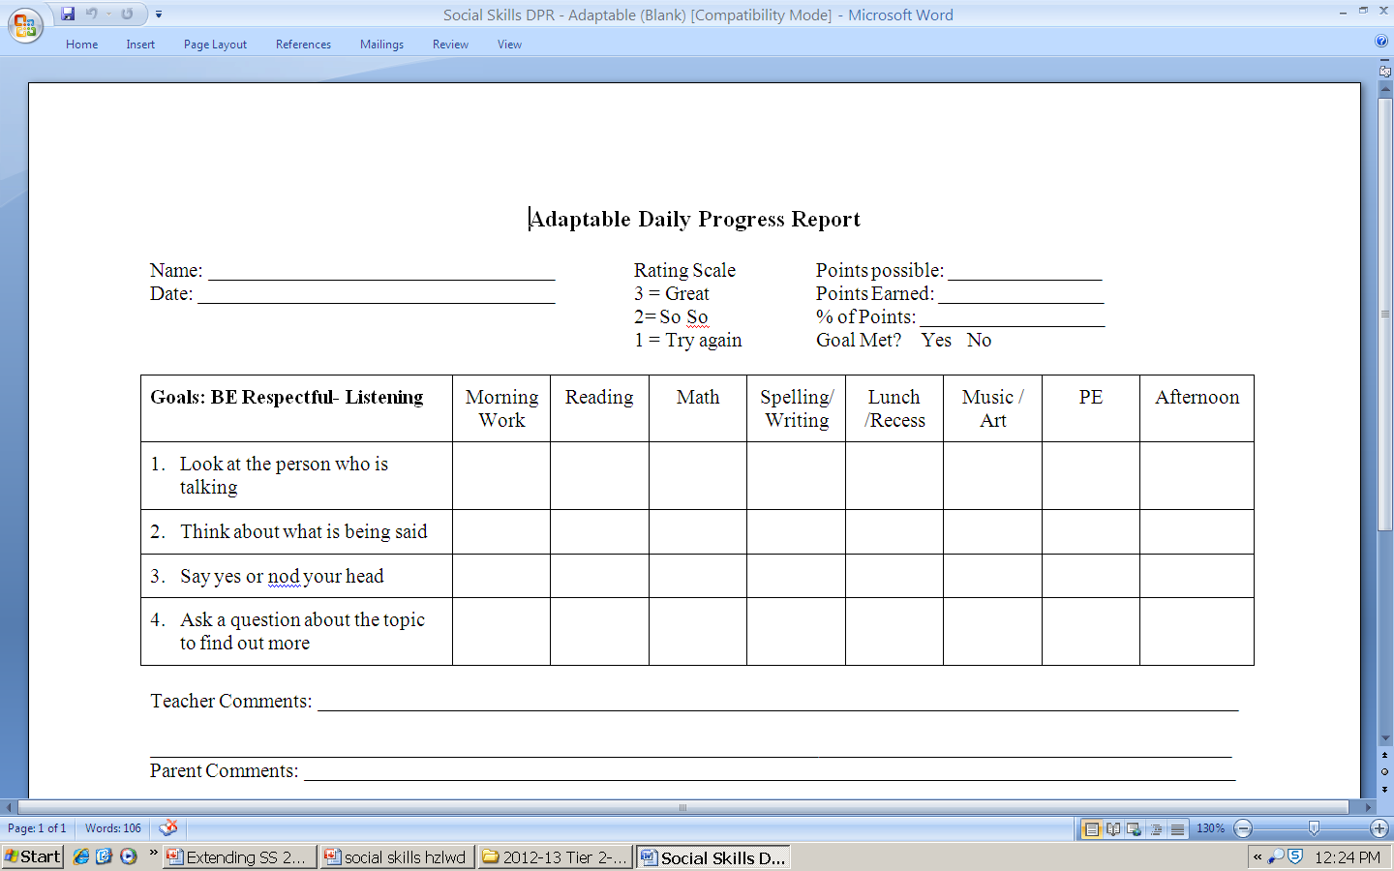
Monitoring Forms

Slide 106
Progress Monitoring
Teacher Progress Report
Social Skill with steps listed: | No Improvement (No Change) | Some Improvement (appropriate use of the skill 1-3 times but still uses competing behavior) | Great Improvement (appropriate use of the skill 4-6 times with rare use of competing behavior) | Competent (appropriate use of skill with 0 use of competing behavior)
Asking for Help
Complete every two weeks
Notes:
So to forms of monitoring
Are 70% responding?
What point are the students at – no names just 10/12 are meeting goal for last three weeks
If not, what data decision rules might you need to follow- modifying, graduating, exiting
Long term- were these interventions effective? Are we matching their function. Intensity?

Slide 107
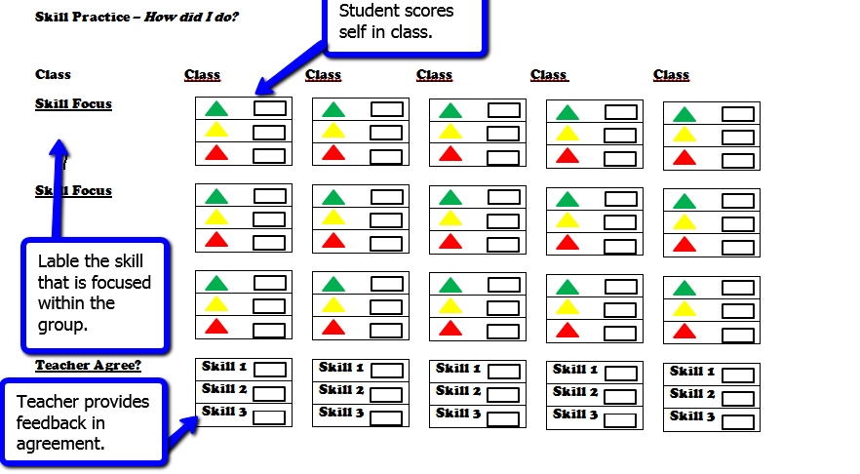
Progress Monitoring
Notes:
So to forms of monitoring
Are 70% responding?
What point are the students at – no names just 10/12 are meeting goal for last three weeks
If not, what data decision rules might you need to follow- modifying, graduating, exiting
Long term- were these interventions effective? Are we matching their function. Intensity?

Slide 108
Monitoring Social Skills
Week 1
3 = Displayed Consistently 2 = Displayed periodically/inconsistently 1 = Did not display
Week’s Percentage _______
 | Targeted Social Skills | Monday | Tuesday | Wednesday | Thursday | Friday | Comments
Be Respectful | Taking turns in conversation | 3 2 1 | 3 2 1 | 3 2 1 | 3 2 1 | 3 2 1
 | Total Daily Points |  |  |  |  |  | Total Points for Week _____
 | Total Possible Daily |  |  |  |  |  | Pts. Poss. For Week _____

Slide 109
Monitoring Social Skills
3 = Displayed Consistently 2 = Displayed periodically/inconsistently 1 = Did not display
Week’s Percentage _______
 | Targeted Social Skills | Monday | Tuesday | Wednesday | Thursday | Friday | Comments
Be Respectful | Taking turns in conversation | 3 2 1 | 3 2 1 | 3 2 1 | 3 2 1 | 3 2 1
 | Disagreeing respectfully | 3 2 1 | 3 2 1 | 3 2 1 | 3 2 1 | 3 2 1
Be Responsible | Paying attention to your work | 3 2 1 | 3 2 1 | 3 2 1 | 3 2 1 | 3 2 1
 | Asking for help | 3 2 1 | 3 2 1 | 3 2 1 | 3 2 1 | 3 2 1
 | Total Daily Points |  |  |  |  |  | Total Points for Week _____
 | Total Possible Daily |  |  |  |  |  | Pts. Poss. For Week _____

Slide 110
Monitoring Social Skills
 | Targeted Social Skills | Monday | Tuesday | Wednesday | Thursday | Friday | Comments
Be Respectful | Taking turns in conversation | 3 2 1 | 3 2 1 | 3 2 1 | 3 2 1 | 3 2 1
 | Disagreeing respectfully | 3 2 1 | 3 2 1 | 3 2 1 | 3 2 1 | 3 2 1
Be Responsible | Paying attention to your work | 3 2 1 | 3 2 1 | 3 2 1 | 3 2 1 | 3 2 1
 | Asking for help | 3 2 1 | 3 2 1 | 3 2 1 | 3 2 1 | 3 2 1
Be Safe | Staying calm when receiving feedback | 3 2 1 | 3 2 1 | 3 2 1 | 3 2 1 | 3 2 1
 | Staying calm when pushed or hit | 3 2 1 | 3 2 1 | 3 2 1 | 3 2 1 | 3 2 1
 | Total Daily Points |  |  |  |  |  | Total Points for Week _____
 | Total Possible Daily |  |  |  |  |  | Pts. Poss. for Week _____

Slide 111
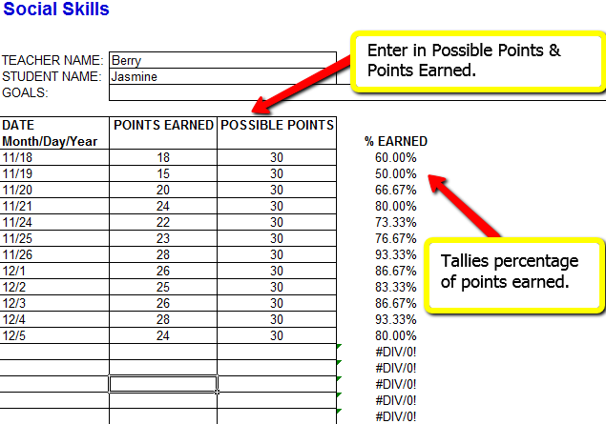
COLLECT & ENTER IN DATA

Slide 112
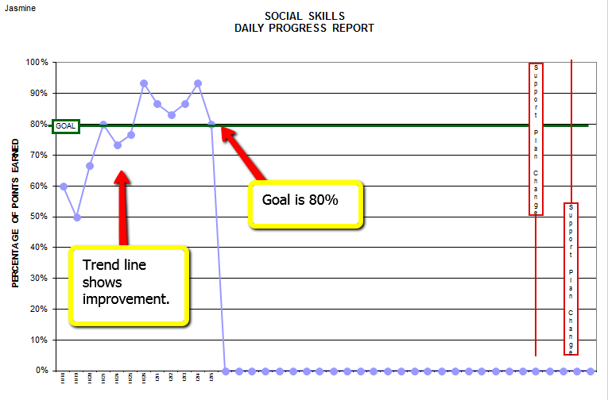
SOCIAL SKILLS PROGRESS REPORT

Slide 113
TIER 2 TRACKING TOOL
Tier 2 Interventions | CICO |  | Social Skills
 | # Students Participating | # Students Responding | # Students Participating | # Students Responding
January
February
March

Slide 114
Treatment Integrity
Monitor the extent to which interventions are implemented as planned, so that the school staff can be confident that the improvements they see are a result of the intervention (treatment integrity; Gresham, 1989).
When intended results do not occur, is it due to insufficient implementation or low treatment integrity?
Notes:
Are we implementing the intervention as designed?

Slide 115
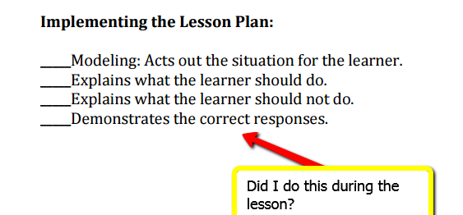
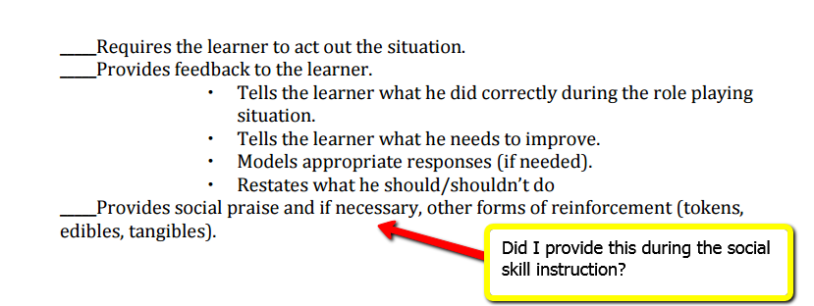
Treatment Integrity within Skill Streaming
Notes:
Are we implementing the intervention as designed?

Slide 116
Treatment Integrity Checklist
Directions: Write “yes” or “no” in response to each question. Fill out this form daily.
Feature |  | Question/description | Monday | Tuesday | Wednesday | Thursday | Friday
 | 1
 | 2
 | 3
 | 4
 | 5
 | 6
 |  | Teacher initials
 |  | Comments
Notes:
Create your own treatment integrity tool, will have reading and supply examples
Right now – think about what has been done at Tier 1 or anything else going on in school (academic interventions, scope and sequence, other work -), how is it monitored that it is happening as intended? and make connections to Tier 2/3
Connections to academics and treatment integrity

Slide 117
Social Validity
Social Significance – will this intervention improve the student’s quality of life? GOAL
Social acceptability –Do all agree that the intervention is necessary, appropriate, supports positive outcomes, minimally disruptive and worth the effort to attain the goal? PROCEDURES
Social importance –Does this intervention have the potential to produce socially important OUTCOMES?

Slide 118
Social Skills Pre- Social Validity | Strongly Disagree | Disagree | Slightly Disagree | Slightly Agree | Agree | Strongly Agree
 | 1 | 2 | 3 | 4 | 5 | 6
1. Social Skills is an acceptable intervention for our school.
2. Social Skills is appropriate to meet the needs of our students.
3. Social Skills includes parent engagement and reciprocal home-school communication as an important feature.
4. Social Skills will be easy to implement.
Collins, 2010, Adapted from SCHOOL-BASED INTERVENTIONS The tools You Need to Succeed. Kathleen Lynne Lane and Margaret Beebe-Frankenberger. Copyright 2--4 Pearson Education, Inc.
Notes:
This an example we provided to schools just starting implementation of PBIS. So you can see that the survey is on a likert scale and the questions are designed around the significance, acceptable, and importance.
More information will come in depth tomorrow.

Slide 119
Reinforcement System

Slide 120
Reinforcement, Rewards, Feedback, Evaluation
Reinforcement - rewarding for particular actions for the purpose of changing a subject’s behavior
Rewards - something desirable given in return for what somebody has done
Feedback - provides information on what student did well and what was in error (When correct - tell students what was correct; when error - tell students what was wrong)
Evaluation - examine something to judge (Good job; bad job)

Slide 121
REWARDS/Incentives
How do you determine what rewards/incentives will be given
  Develop a menu
  Use a student survey to determine their preferences
  Connect to school-wide acknowledgment system.
  Determine how you will fade use of tangible/ extrinsic rewards and increase appropriate ways for getting adult attention

Slide 122
Developing a Reinforcement System
Most schools include an opportunity for small daily rewards (Note: should always be paired with social praise).
*Sticker or special pencil *School token, high five, school-wide ticket
Some students benefit from the opportunity to earn larger reward. These can be tracked by points on a credit card, stickers on a chart, tickets.
  *Free time (gym, computer, time with friends)
  *Lunch with preferred adult
  *Coupons to snack bar, movie theater, school store
Notes:
Connection again to school-wide reinforcement system.

Slide 123
TRAINING SOCIAL SKILL STAKEHOLDERS

Slide 124
Staff Roles & Responsibilities - ADMINISTRATOR
                Provides support and feedback to staff
                Provides resources (time & money)
                Serve as a guest social skills instructor
Notes:
Tier 2 prevention is designed for students who are not responding to the Tier 1 level of support.

Slide 125
Staff Roles & Responsibilities – CLASSROOM TEACHER
                Has taught students to follow the school-wide expectations and implements effective classroom management techniques
                Interacts with student positively
                Prompts for use of social skill
                Provides positive & corrective feedback to student each hour
                Records hourly on daily progress report
Notes:
Tier 2 prevention is designed for students who are not responding to the Tier 1 level of support.

Slide 126
Staff Roles & Responsibilities - COORDINATOR
                Provide Social Skills teachers with knowledge and/or training on direct instruction for social skills prior to meeting with children
                Distribution of Social Skills materials and lessons
                Develop logistics-consistent time and location for staff and students and what to do if there is a substitute
                Development of specific generalization efforts
                Shares student and intervention data with stakeholders monthly
Notes:
Tier 2 prevention is designed for students who are not responding to the Tier 1 level of support.

Slide 127
TRAINING STUDENTS
                Purpose of the group is understood
                Procedures/structures of learning sessions: teach, model, role-play, practice with feedback and generalization
                Logistics- Consistent time and location of group
                Recognition and acknowledgement system
                Self-monitoring social skills
                Generalization-How to use skills in class and other environments
Notes:
Purpose of the group to use practical examples in the student’s school life. Provide the structure of what the lessons will look like, such as teach, model, practice, role-play, feedback and generalization procedures.
Will students participate? Are we interviewing students? Do they see the purpose?

Slide 128
ENCOURAGE PARENT INVOLVEMENT
                Orientation meeting
                Parent letter
                Parent survey
                Share video clips
                Progress reports
                Observation of a lesson
                Teach them
                Involve them
Notes:
Purpose of the group to use practical examples in the student’s school life. Provide the structure of what the lessons will look like, such as teach, model, practice, role-play, feedback and generalization procedures.
Will students participate? Are we interviewing students? Do they see the purpose?

Slide 129
TRAINING SOCIAL SKILL STAKEHOLDERS
What recommendations might you provide regarding:
How and when staff would be trained?
How and when you train/recruit additional teachers?
How and when you will inform parents and students?

Slide 130
Action Planning
30 minutes
Use the Intervention Essential Features Action Planning Tool to build the Social Skills Intervention
Complete Intervention Guideline
Discuss and answer curriculum questions
Determine how Social Skills Intervention will become an agenda item on Tier 2 Systems meeting.
Notes:
15 minutes for activity. Circulate to tables

Slide 131
Review
What are the critical features of social skills?
What outcomes spoke to you?
What steps will you take to develop a system to support social skill instruction?

Slide 132
STEPS TO IMPLEMENTING SOCIAL SKILLS
1. Assess
– Identify most common social skill deficits
2. Develop Curriculum
– Bank of lessons readily available to address skills deficit
3. Teach
– Tell, Show, Practice, Practice, Practice
4. Establish Procedures
– Logistics of facilitating the Social Skills Intervention & Group Management techniques
5. Plan for Maintenance & Generalization
– Consistent use of skills over time & across variety of settings

Slide 133
Critical Features of Social Skills Groups
Selecting Curriculum (Description)
Training of Social Skills Instructors (Intervention Plan)
Identification of Students (Entry Criteria)
Providing Effective Instruction (Intervention Plan)
Managing the group (Intervention Plan)
Evaluating Results (Monitoring and Exit)
Planning for Generalization (Intervention Plan)
Notes:
These will be the main points that we are covering today, we will be thinking about the critical features of social skills and how

Slide 134
Professional Learning Outcomes
By January 2016, schools attending will have started to support a group of students, including students with disabilities, with social skill instruction.
By May 2016, schools attending will have and use systems and practices (defined in an implementation manual) for Tier 2 Social Skills Practices to support students who may benefit

Slide 135
Participant Outcomes
Learn systems and practices needed for a Tier 2- Social Skills intervention.
Facilitate action steps for installing Tier 2: Social Skills strategies with their PBIS 2/3 systems team.
Plan, teach, and monitor all critical components of Tier 2: Social Skills Strategies.

Slide 136
Student Outcomes
10-15% of student body will access Tier 2 interventions which includes students with disabilities.
70% or more, of students accessing Tier 2 and/or Tier 3 interventions will respond positively.

Slide 137
CUE USE
Share with staff what you have learned about:
Identification of Students
Training of Social Skills Instructors
Providing Effective Instruction
Managing the Group
Selecting Curriculum
Evaluating Results
Planning for Generalization

Slide 138
COACHING SUPPORT
Please schedule a coaching visit with your PBIS facilitator
We would like to schedule with you before the holiday break

Slide 139
THANK YOU!

